Slide 1
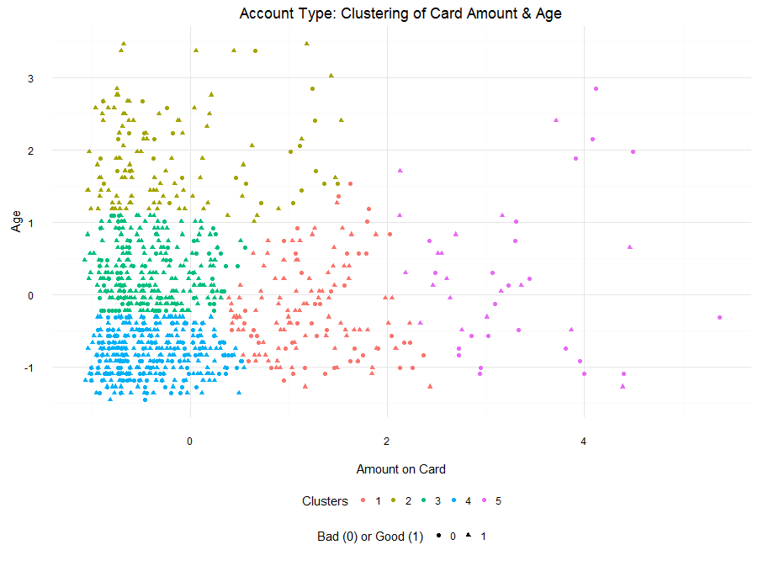
Clusters | Amount | Age | Bad Account | Good Account | Bad Account%
1 | 1.21 | -0.23 | 48 | 95 | 33.6%
2 | -0.23 | 1.90 | 28 | 104 | 21.2%
3 | -0.41 | 0.30 | 75 | 219 | 25.5%
4 | -0.41 | -0.82 | 125 | 263 | 32.2%
5 | 3.24 | 0.22 | 24 | 19 | 55.8%

